Slide 1

Online Home Rental
A Final Presentation On Implementation

Slide 2

Table of Contents
Team Members
About "Project-II"
Motivation behind Project-II
Design Overview
Technologies Used
Requirements
Implementation overview
Live demonstration
QNA

Slide 3
TEAM
1. Anil Kumar Tiwari
2. Bidhata Pandey
3. Lokesh Subedi
4. Prasiddhi Adhikari
Coordinator
Udaya Raj Dhungana
Supervisor
Rajesh Kumar

Slide 4
INTRODUCTION
is a web-based platform to make the connection between tenant and Home-owner.
rental system where people can acquire affordable houses and rooms.
can be applicable to every individual who needs to rent flats or rooms.
can be used by students or job holders who are away from their homes.

Slide 5

Why this project?
To quickly locate a rental home/Room.
To create a system that can create list of the user's preferred locations.
To save time and cost.

Slide 6

TECHNOLOGY USED
JavaScript
HTML
CSS
PHP
MYSQL

Slide 7
Hardware and Software Requirements
Hardware Requirements
Software Requirements
Intel Pentium 4 Processor
20GB Hard Disk Drive Space
512MB RAM
Operating System
Windows 7/8.1/10/11
Servers
Xampp
IDE
VsCode
.NET Framework 3.1

Slide 8

Design Overview
Front Page
Login Page
Register Page
Admin Panel
User Panel
Database
Hosting and Details

Slide 9


Slide 10
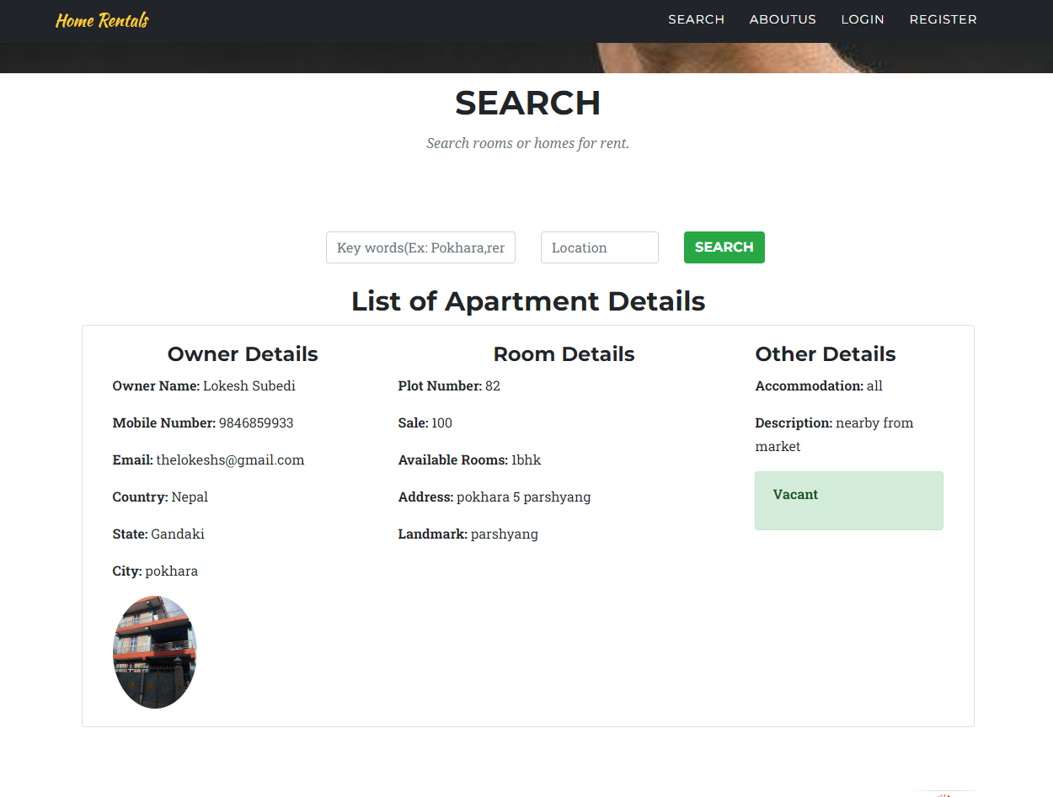
Search Option

Slide 11
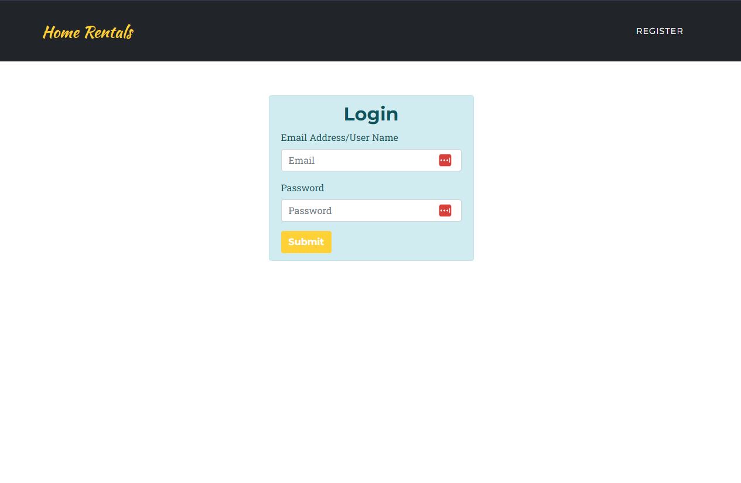
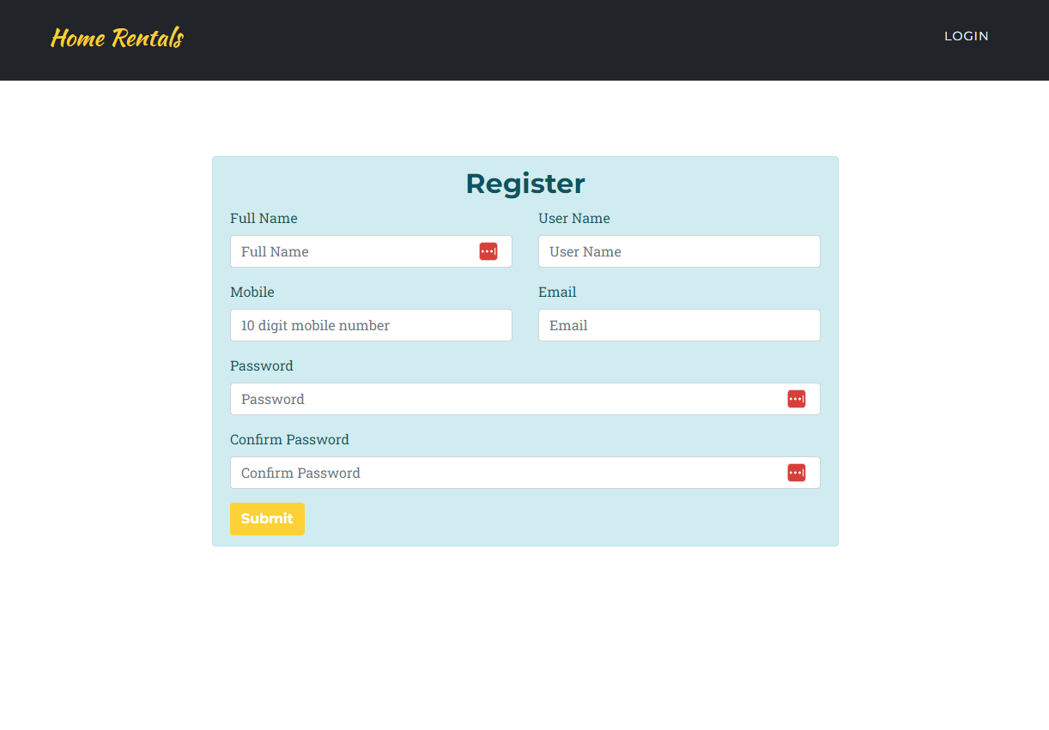
Login And Register

Slide 12
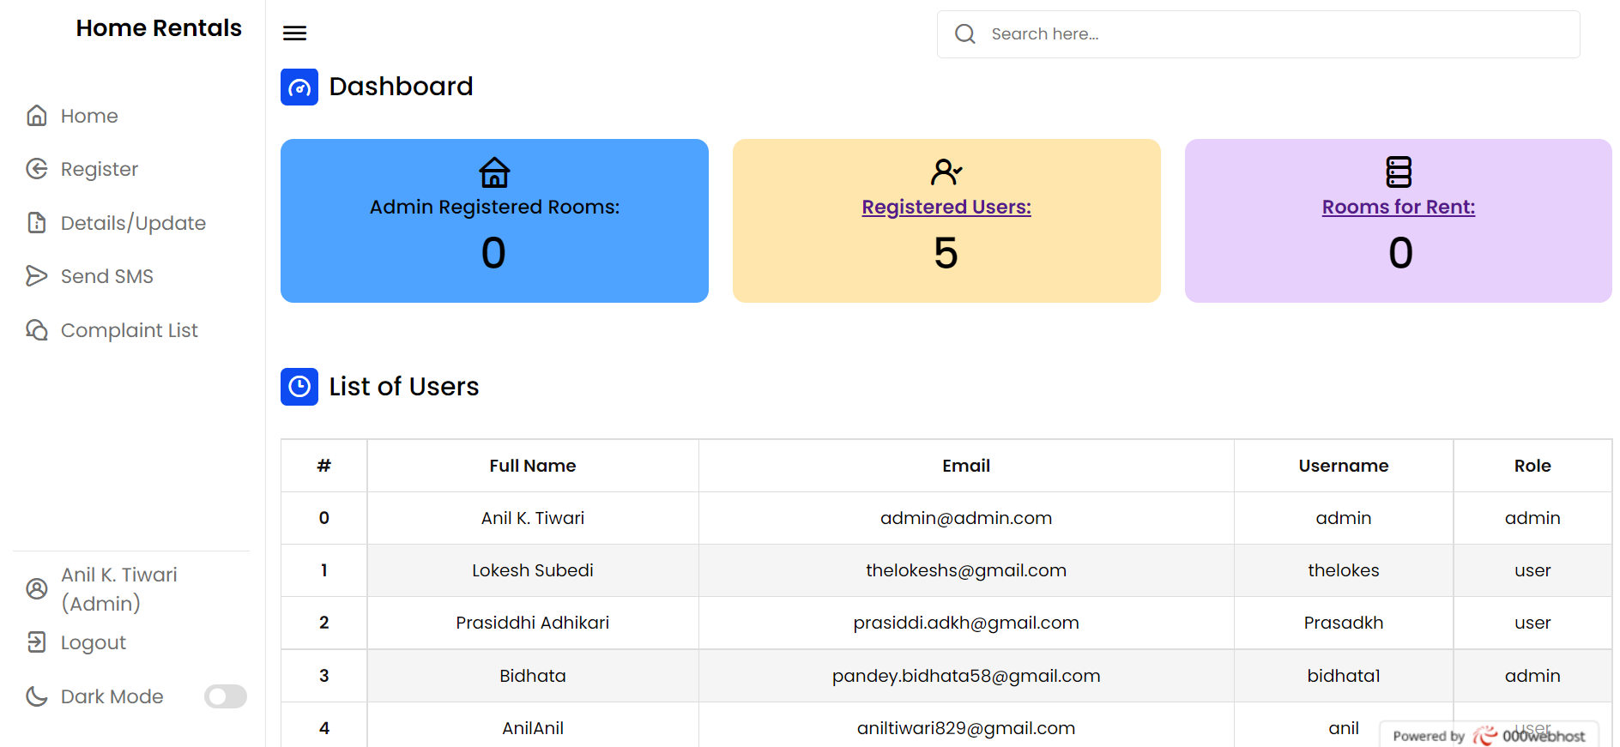
Admin Panel

Slide 13
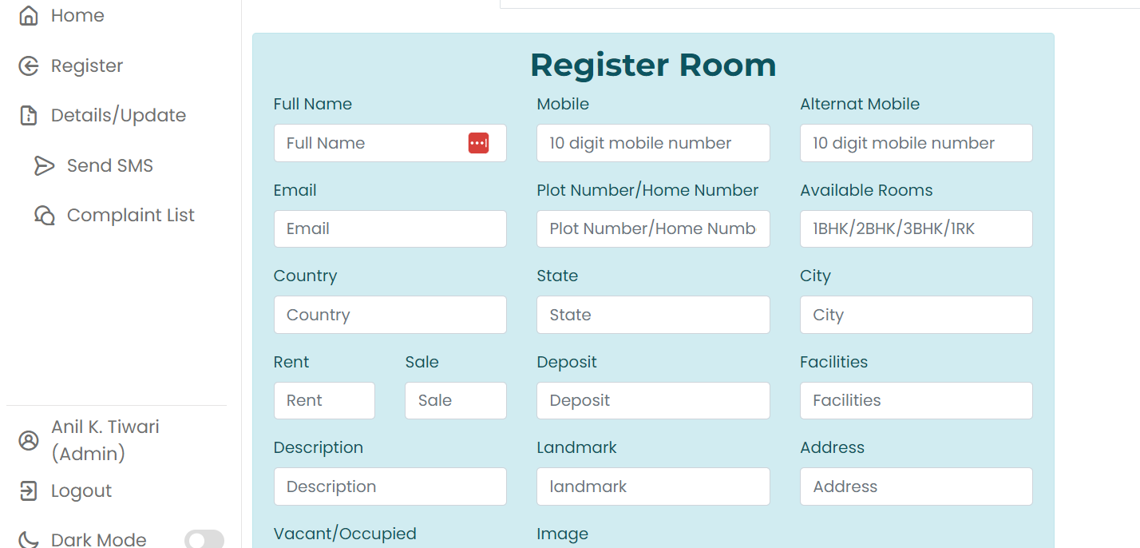
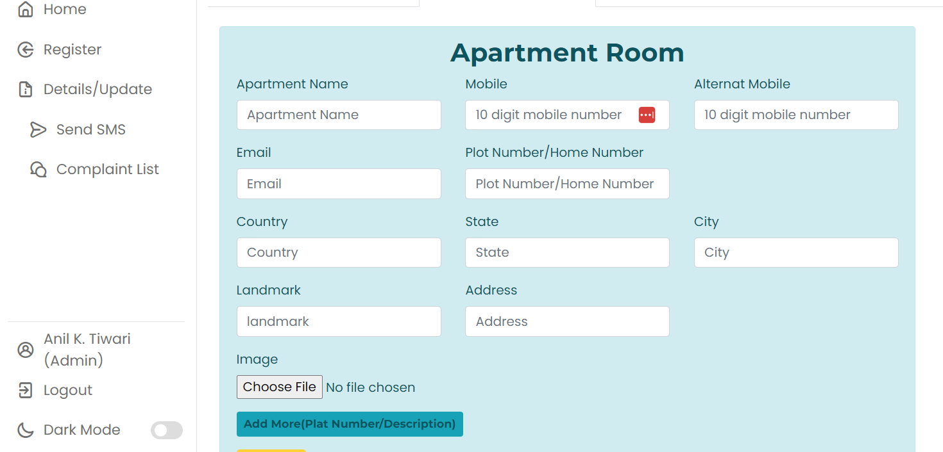
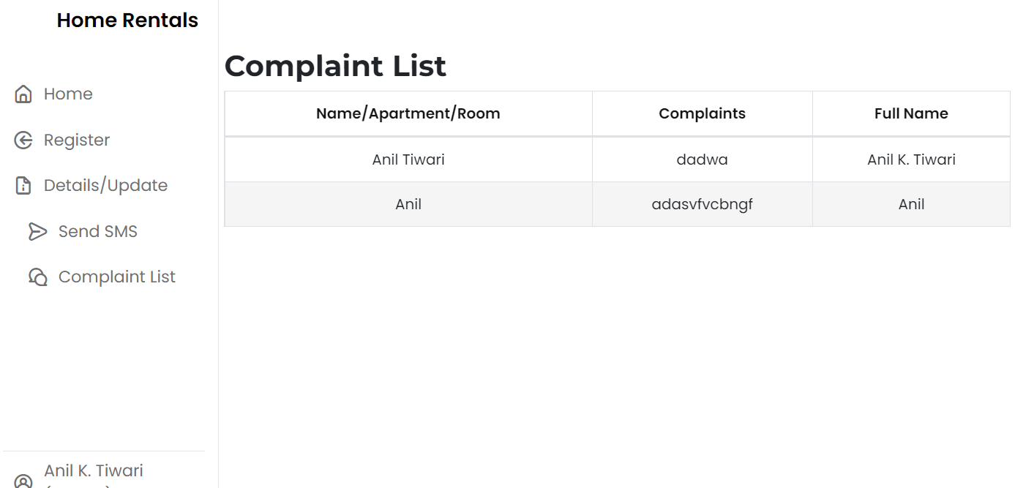
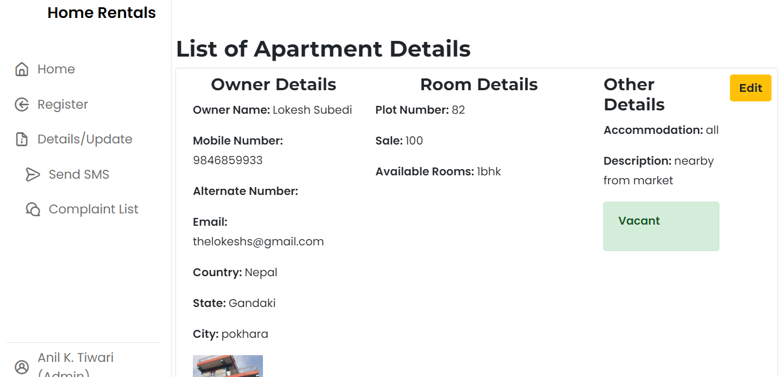

Slide 14
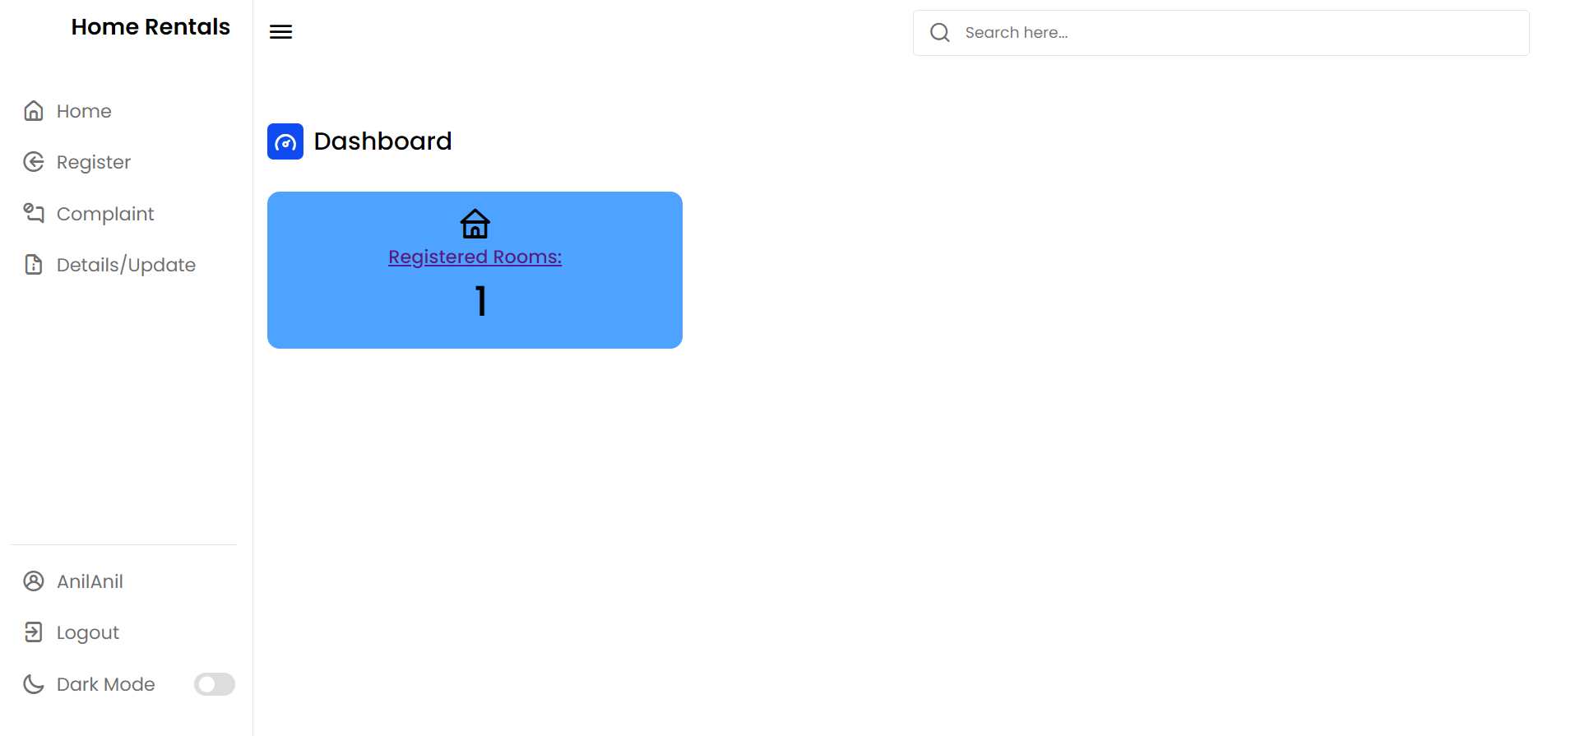
User Panel

Slide 15
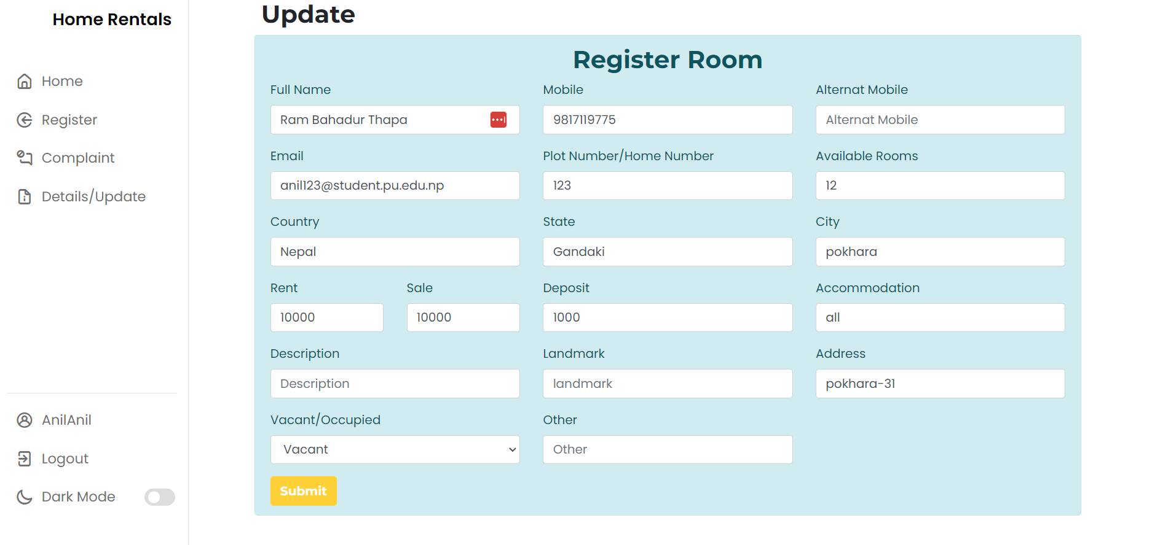
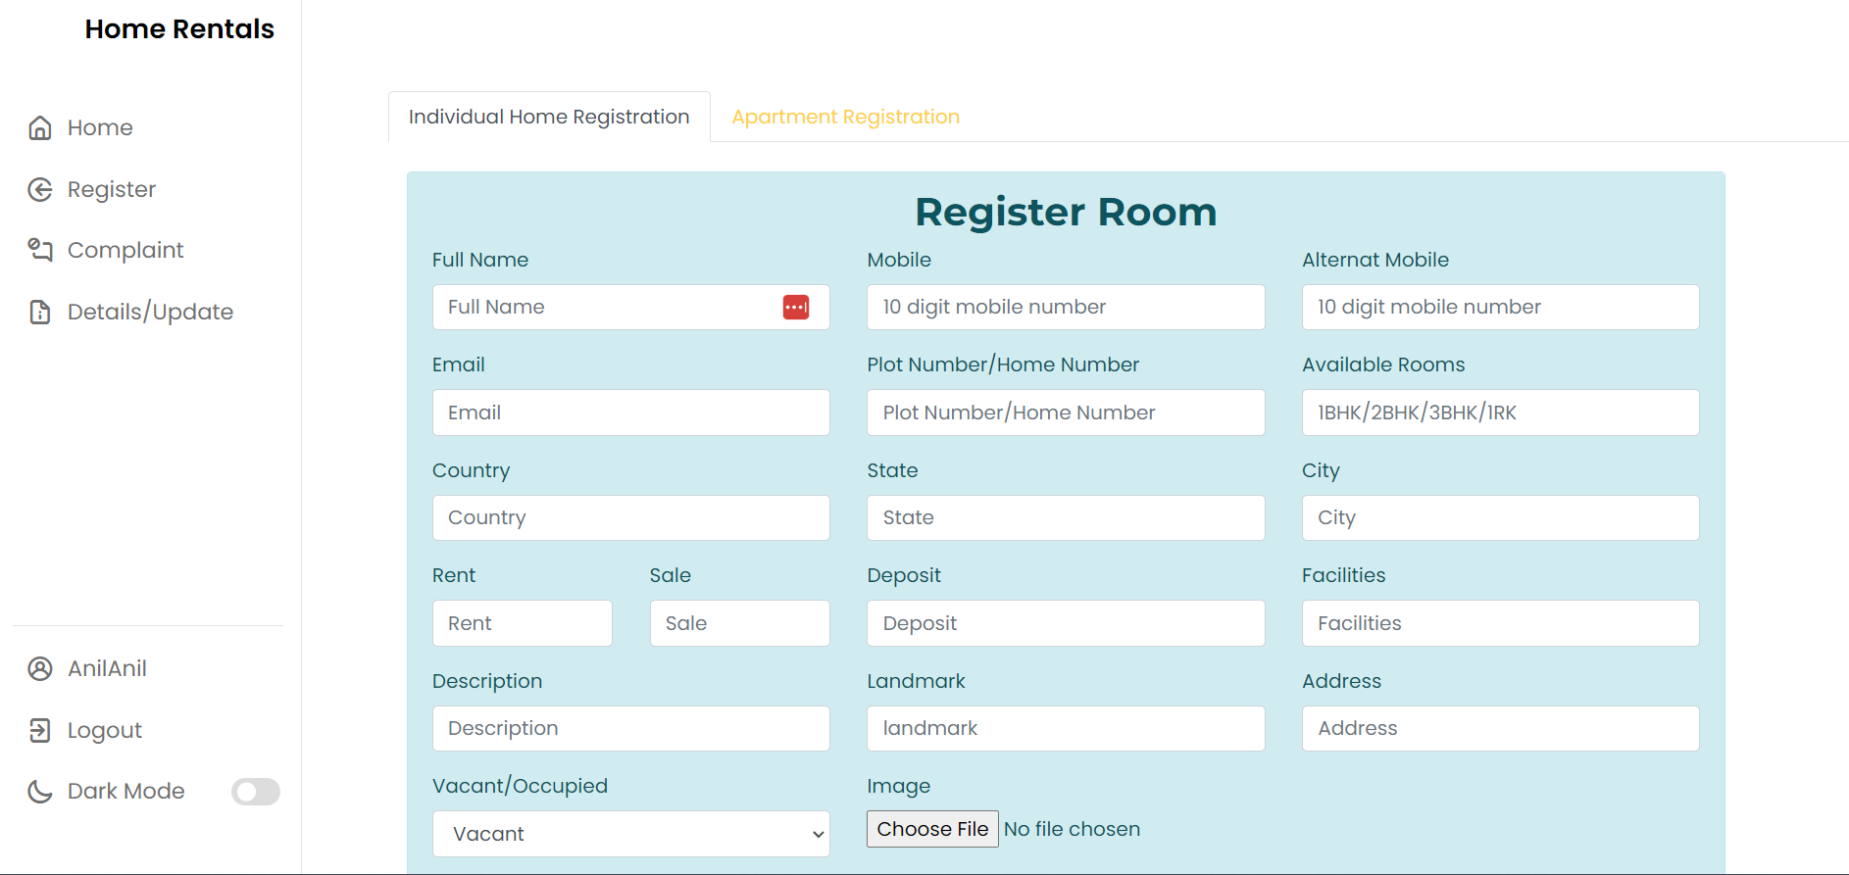
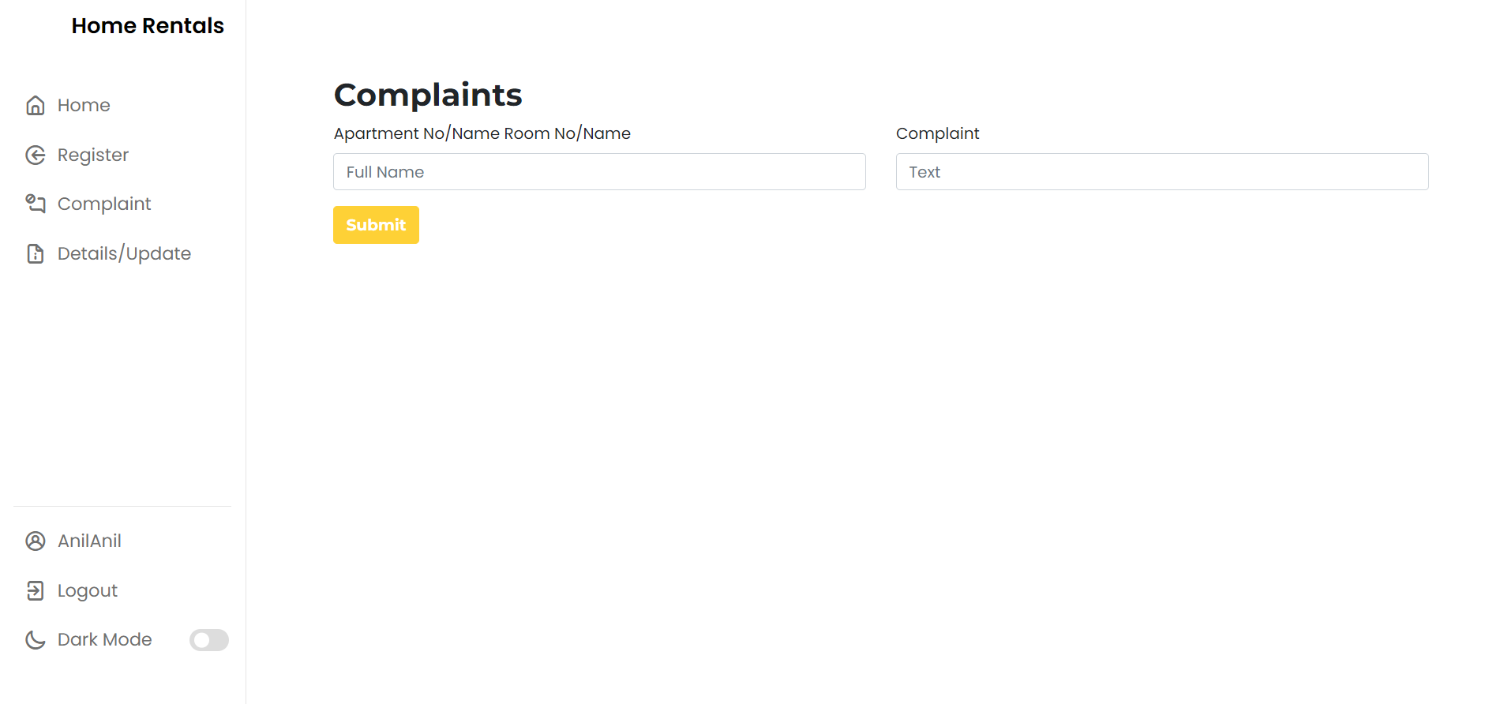
Register Room/Home, Update and Complaint

Slide 16
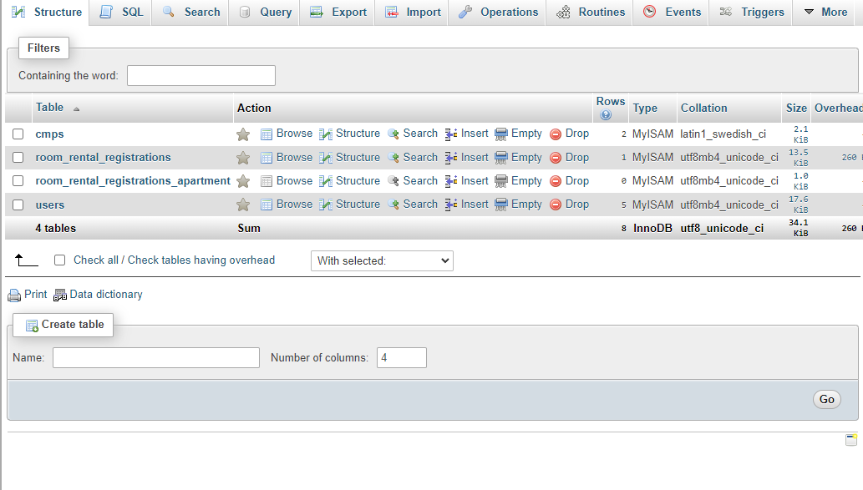

Slide 17
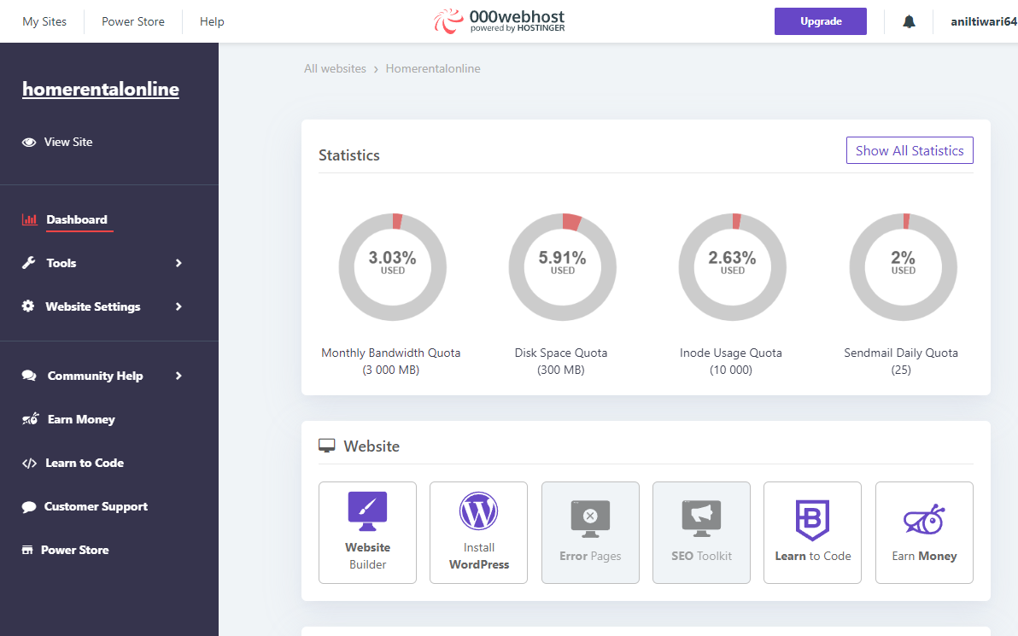
Hosting and Domain

Slide 18

Live Demonstration

Slide 19


Slide 20


